Slide 1
Lending Club Case Study

Slide 2
Business Objective
Detailed study about EXPLORATORY DATA ANALYSIS with the help of a case study.
Use EXPLORATORY DATA ANALYSIS to understand how consumer attributes and loan attributes influence the tendency of default.

Slide 3
Statement:
• Lets say a consumer finance company which provides various types of loans to urban customers. When the company receives a loan application, the company has to make a decision for loan approval based on the applicant's profile.
Two possibilities are associated with the bank's decision:
• If the applicant repays the loan, then not approving the loan lead to a loss of business to the company.
• If the applicant is doesn’t repay the loan, the applicant is likely to default, then approving the loan may lead to a financial loss for the company.

Slide 4
Challenges:
When a person applies for a loan, there are two types of decisions that could be taken by the company:
Loan accepted: if the company approves the loan, there are 3 possible scenarios described below:
Fully paid: applicant has fully paid the loan (the principal and the interest rate)
Current: applicant is in the process of paying the instalments, i.e. The tenure of the loan is not yet completed. These candidates are not label as 'defaulted'.
Charged-off: applicant has not paid the instalments in due time for a long period of time, i.e. He/she has defaulted on the loan: the company had rejected the loan (because the candidate does not meet their Requirements etc.). Since the loan was rejected, there is no transactional history of those applicants with the company and so this data is not available with the company (and thus in this dataset)
Loan rejected: If the loan is rejected due to the reasons like applicant doesn’t meet the requirement, there is no transactional history of those applicants with the company and so this data is not available.

Slide 5
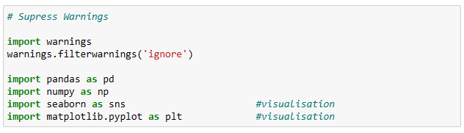
Step 1:
Import the required libraries for EDA

Slide 6

Step 2:
Loading the data into the frame.

Slide 7
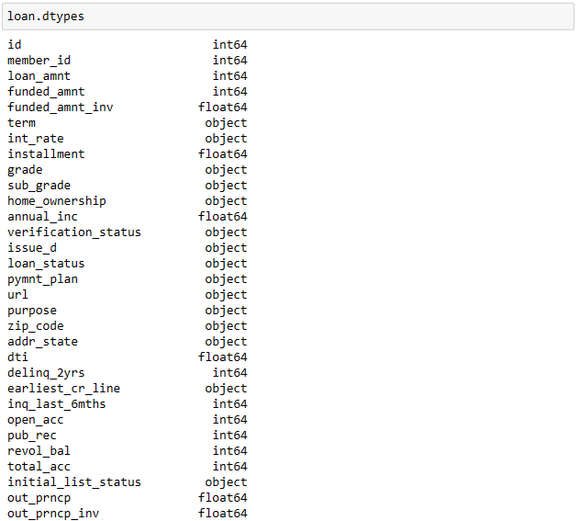
Step 3:
Checking the types of data.

Slide 8
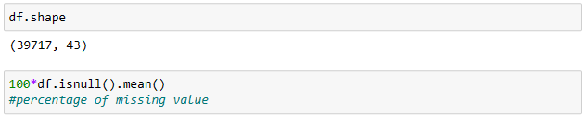
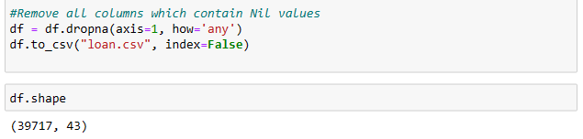
Step 4:
Dropping irrelevant columns.
Remove columns with nil values.

Slide 9

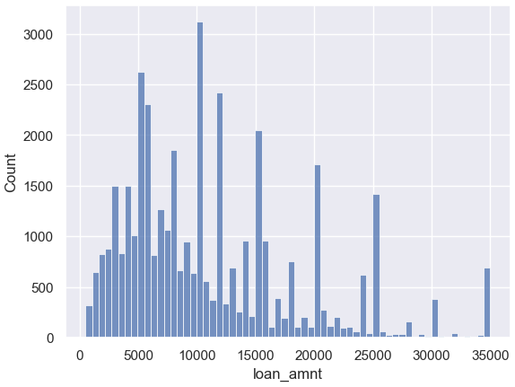
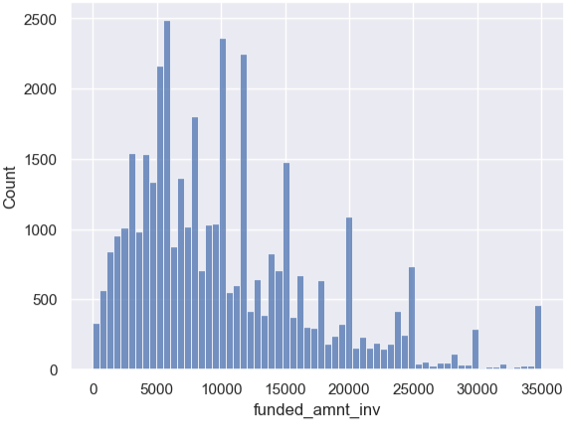
Step 5:
Univariate Analysis – Numerical.

Slide 10

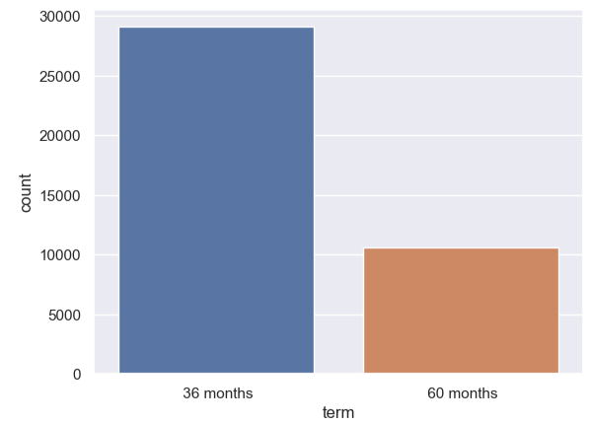
Step 6:
Univariate Analysis - Categorical.
We see that customers prefer 36 months of tenure more compared to 60 months.

Slide 11
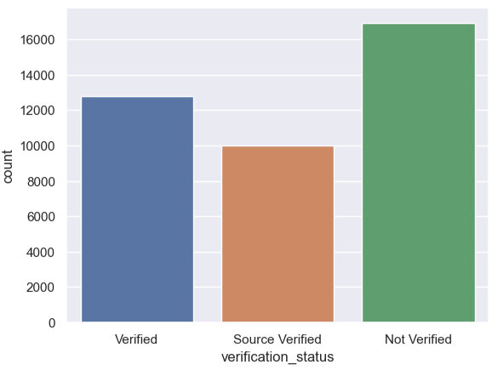
Step 7:
Univariate Analysis - Categorical.
We see that highest rate of customers with loan tenure of 60 months are not verified. This might lead bank into loss.

Slide 12
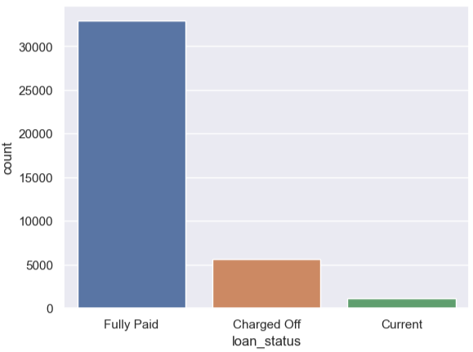
Step 8:
Univariate Analysis - Categorical.

Slide 13

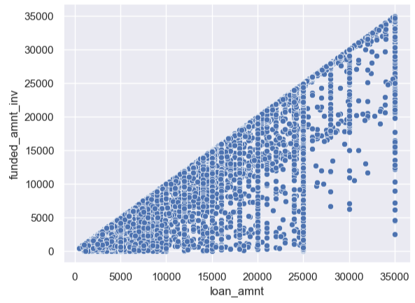
Step 9:
Bivariate Analysis - Numerical.

Slide 14

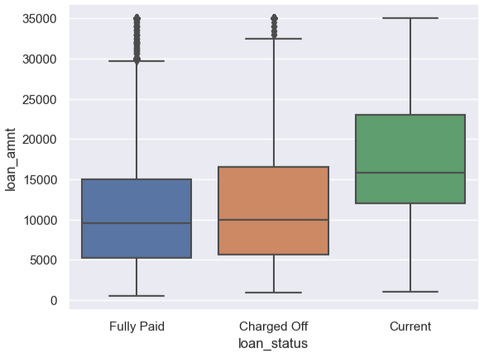
Step 10:
Description pending

Slide 15

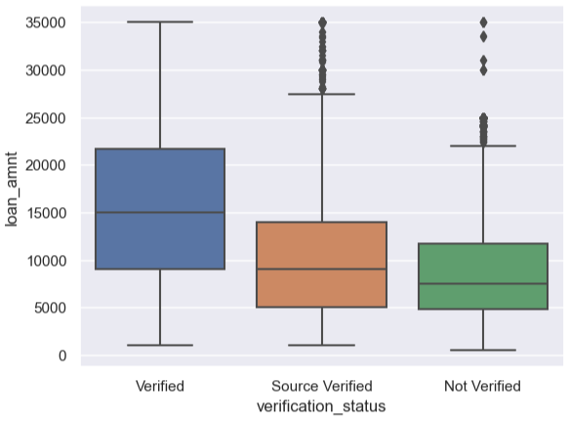
Step 11:
Description pending

